Slide 1
DSO599 - Capstone Project
Supermarket Data Analysis using SQL
9751080834
Yi-Chun Chi

Slide 2
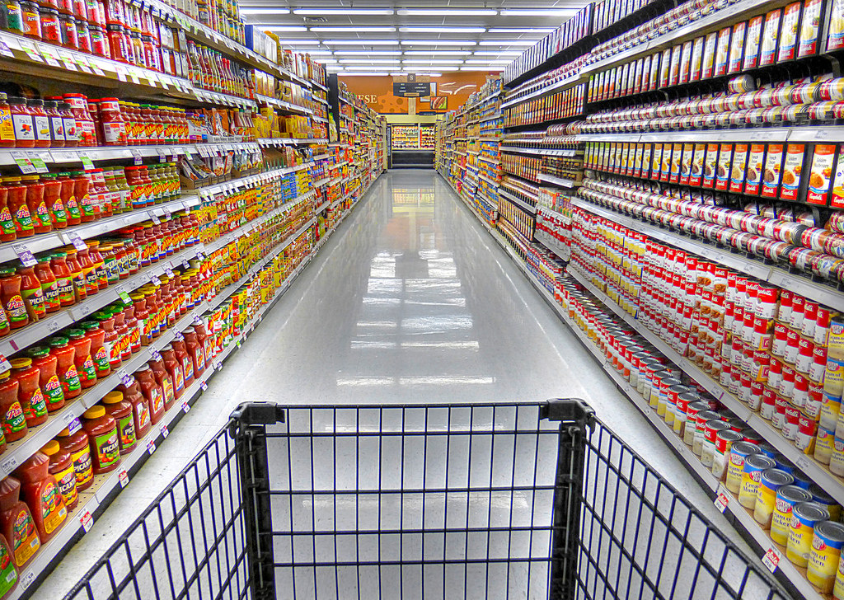
Tracking shoppers’ path to purchase

Slide 3

Shopper’s aisle list
We want to know all unique aisle id in each order
So we join order_product table and aisle table
Group by order_id and aisle_id to get the result we want and also to avoid duplicate aisle values in each order

Slide 4
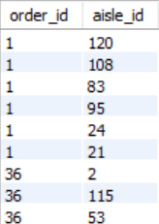
Shopper’s aisle list
For instance, in order 1 the shopper visited aisle 120, 108, 83, 95, 24 and 21
The combination of aisles in each order is the shopping path for that order

Slide 5

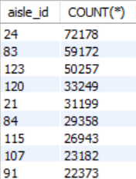
Most popular shopping path
Let's only focus on the most popular shopping path among top 50 aisles and top 100 products
So first we create a table of top 50 aisle visited by customers
We can get our result by sorting the total counts in each aisle from shopping path table

Slide 6

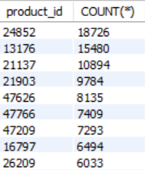
Most popular shopping path
Likewise, we create a table of top 100 products bought by customers
We can get our result by sorting the total counts in each product from order product table

Slide 7
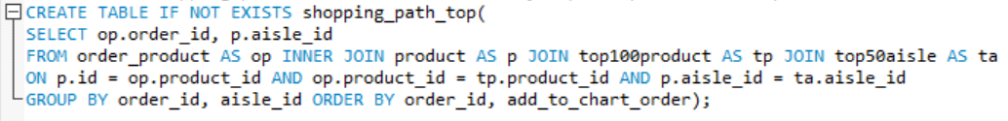
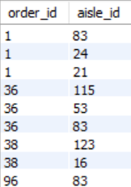
Most popular shopping path
By joining the order product table with the top 50 aisles and top 100 products table that we just created, we can get a shopping path table that contains only top 100 products in top 50 aisles
Original table
Top 50 aisles &
top 100 products

Slide 8

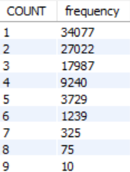
Most popular shopping path
Let’s look at the number of aisles visited by customers in each order
The majority of customers go to 1, 2 or 3 aisles per order
So let's focus on the combination of 2 aisles as well as 3 aisles

Slide 9

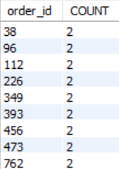
Most popular shopping path
Let's focus on the combination of 2 aisles first
So we create a table of orders that contain exact 2 aisles

Slide 10
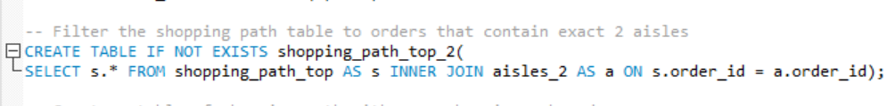
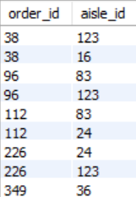
Most popular shopping path
By joining the shopping path table with the table of orders that contain exact 2 aisles, we can filter the shopping path table to orders that contain exact 2 aisles
Original table
Order with exact 2 aisles

Slide 11
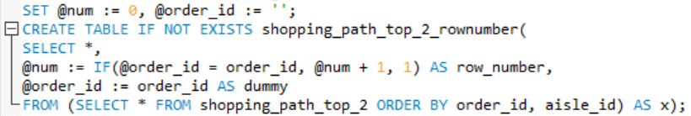
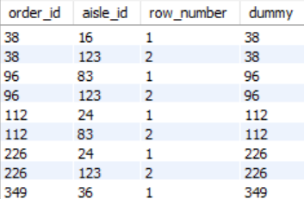
Most popular shopping path
We assign a row number in each order for future usage

Slide 12
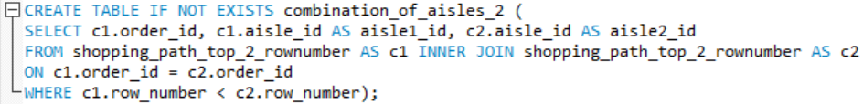
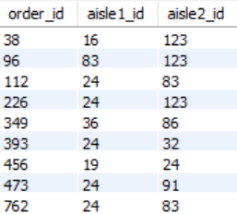
Most popular shopping path
By applying a self join, we can create a table that lists all the combinations of pair of aisles in each order
We use a WHERE clause to avoid duplicate combination

Slide 13
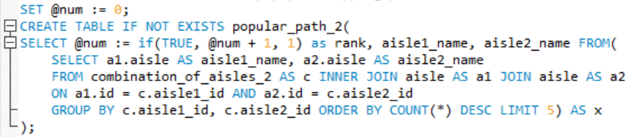
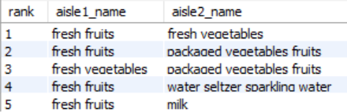
Most popular shopping path
From the aisle combination table that we just created, we can sort by total count of each combination, and list the top 5 popular path
Instead of aisle id, here we use aisle name since names are more strait forward

Slide 14
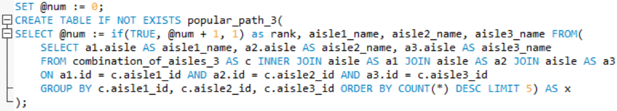
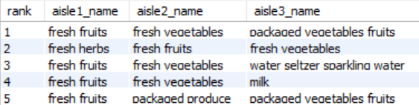
Most popular shopping path
Using the same steps, we can create a table of the top 5 popular path with 3 aisles

Slide 15
Most popular shopping path
The result indicates that consumers usually buy fruits, vegetables, water and milk at the same time
In order to boost our sales, we should arrange these aisles in the same place and make some promotions with products in these aisles

Slide 16
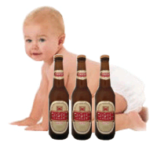
Layout re-arrangement to promote sales

Slide 17
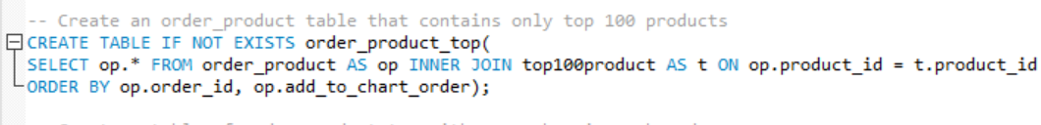
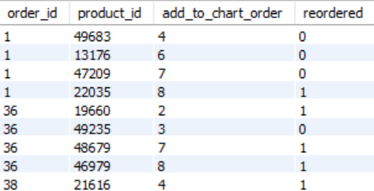
Items most frequently bought together
Let's only focus on the top 100 products
By joining the order product table with the top 100 products table, we can get an order product table that contains only top 100 products

Slide 18
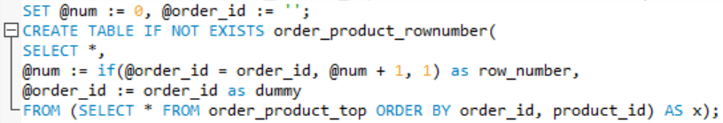
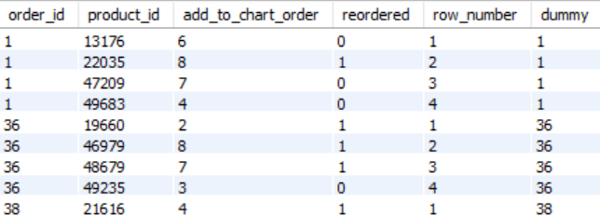
Items most frequently bought together
We assign a row number in each order for future usage

Slide 19
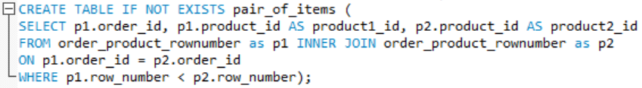
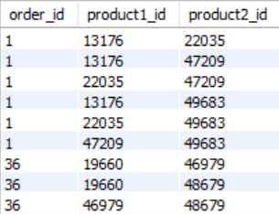
Items most frequently bought together
By applying a self join, we can create a table that lists all the combinations of pair of items in each order
We use a WHERE clause to avoid duplicate combination

Slide 20
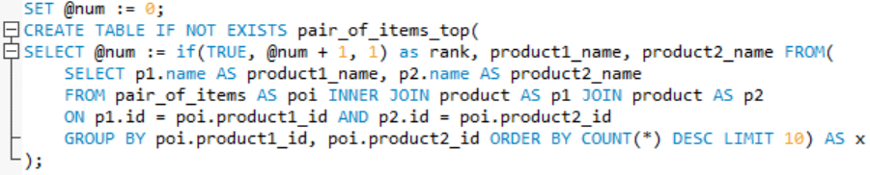
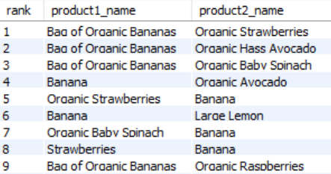
Items most frequently bought together
From the product combination table that we just created, we can sort by total count of each combination, and list the top 10 pair of items
Instead of product id, here we use product name since names are more strait forward

Slide 21
Items most frequently bought together
The result indicates that consumers usually buy fruits, vegetables, organic fruits and organic vegetables at the same time
In order to boost our sales, we should arrange these products in the same place and make some promotions with these pair of products

